Slide 1
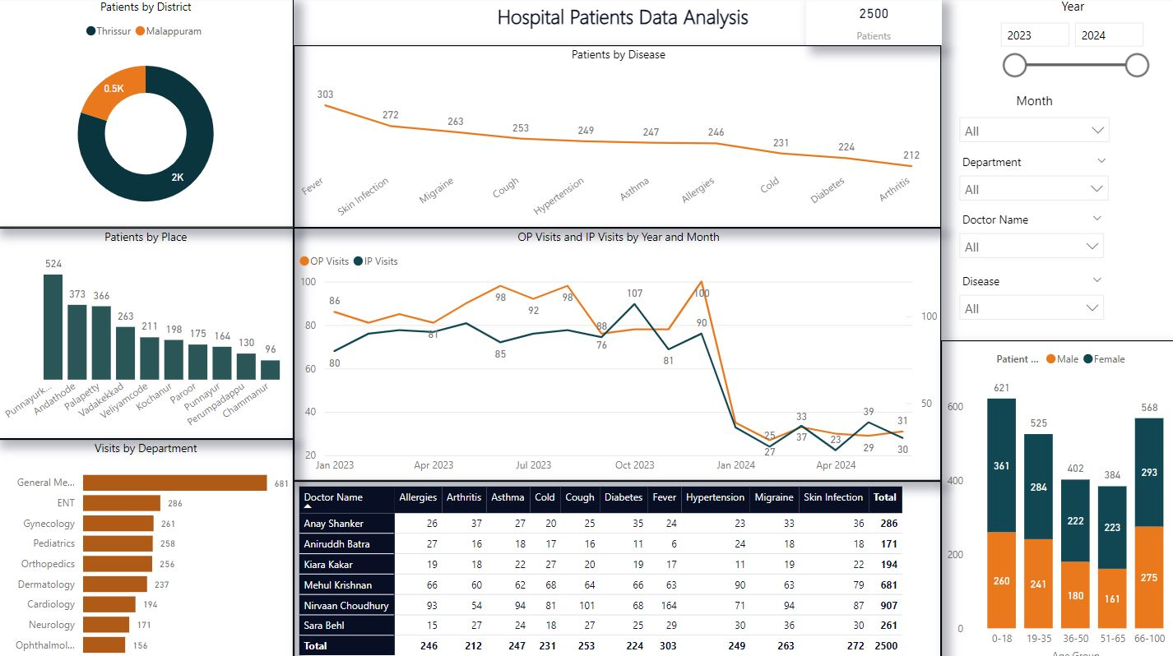

Project Overview:
This project involved developing an interactive dashboard to analyze patient data from a healthcare facility. The dashboard was designed using Python, Power BI, DAX, and Excel, providing both desktop and mobile views for ease of access and navigation.
Transforming data into actionable insights
Patient Record Data Analysis Dashboard
Aneesh Mohanan
MBA | Data Analyst
[Project Dashboard Link]

Slide 2

Patients by Diseases:
Categorized patients based on different diseases, allowing healthcare professionals to track the prevalence of various conditions across the population.
Patients by District & Place:
Analyzed patient demographics by district and place, providing insights into geographical patterns and enabling targeted healthcare strategies.
OP and IP Visits by Month & Year:
Visualized outpatient (OP) and inpatient (IP) visits over time, categorized by month and year, to identify trends in healthcare utilization and seasonal variations in patient inflow.
Visits by Departments:
Monitored patient visits across different departments, helping management assess department workloads and optimize resource allocation.
Patient Demographics (Male/Female):
Segmented patients based on gender, providing gender-based insights into healthcare needs and treatment outcomes.
Doctor Analysis by Patient Visits:
Analyzed the number of patients visited by each doctor, categorized by diseases, enabling performance evaluation and resource planning for the healthcare team.
Key Features:
Aneesh Mohanan
MBA | Data Analyst

Slide 3

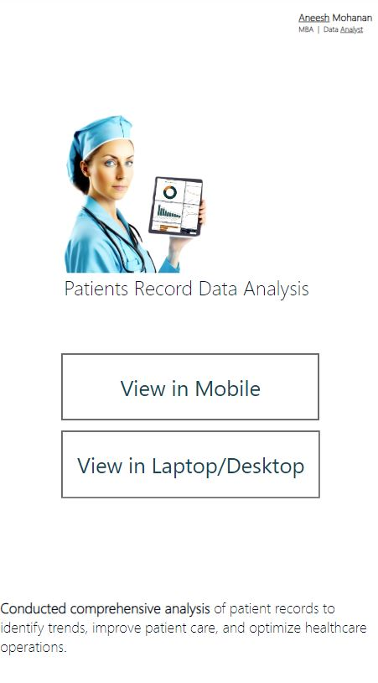
Tools and Technologies Used:
Python: Used for data cleaning and preprocessing, employing libraries like Pandas and Matplotlib for initial analysis and visualization.
Power BI: Created interactive visualizations and dashboards, making it easy for users to explore patient data.
DAX: Implemented dynamic calculations and measures in Power BI to provide real-time insights and actionable data.
Excel: Assisted with initial data organization, ensuring smooth integration into the Power BI dashboard.
Interactive Dashboard Views:
Desktop View: Provides a comprehensive overview of all analysis sections, allowing for deep dives into specific metrics such as disease categories, geographic trends, and department visits.
Mobile View: A streamlined version of the dashboard optimized for mobile devices, ensuring quick access to key data on-the-go.
Aneesh Mohanan
MBA | Data Analyst

Slide 4
Project:
Patient Record Data Analysis Dashboard [Project Dashboard Link]
Portfolio:
Check out my portfolio for more projects like this: [Portfolio Link]
Conclusion:
This project demonstrates my ability to handle large datasets, conduct in-depth analyses, and create dynamic, user-friendly dashboards using a combination of Python, Power BI, DAX, and Excel. The dashboard not only provides critical insights for healthcare management but also enables data-driven decision-making at multiple levels.
Aneesh Mohanan
MBA | Data Analyst

